Slide 1

COVID 19 Detection from radiograph using Computer Vision Deep Learning
Submitted By-
Sunil Kumar 17MI438
Divyanshu Bhaik 17MI446
Rahul Sharma 17MI426
Prayas Thakur 17MI437
Under the guidance of
Dr. Abhijit Bhattacharyya
Assistant Professor
Department of Electronics and Communication Engineering
National Institute of Technology Hamirpur, 177005 Himachal Pradesh

Slide 2
PROJECT OVERVIEW
Coronavirus disease (COVID-19) is an infectious disease caused by a newly discovered coronavirus severe acute respiratory syndrome coronavirus 2 (SARS-CoV-2). Currently, the detection of coronavirus disease 2019 (COVID-19) is one of the main challenges in the world, given the rapid spread of the disease.
Basic method Reverse Transcription-Polymerase Chain Reaction (RT-PCR) test has turned out as a gold standard for identifying COVID-19 patients. However, the RT-PCR test becomes infeasible in the severely affected areas during early outbreak of the pandemic. In addition, the preparation of sample and poor-quality control techniques lead to increase in false-negative rates.
We are working on an an artificial-intelligence technique based on computer vision Deep Learning to detect COVID-19 patients using real-world datasets. Our system examines chest X-ray images to identify such patients. Our findings indicate that such an analysis is valuable in COVID-19 diagnosis as X-rays are conveniently available quickly and at low costs.

Slide 3
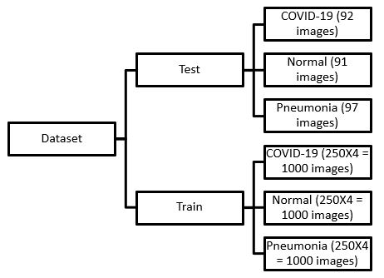
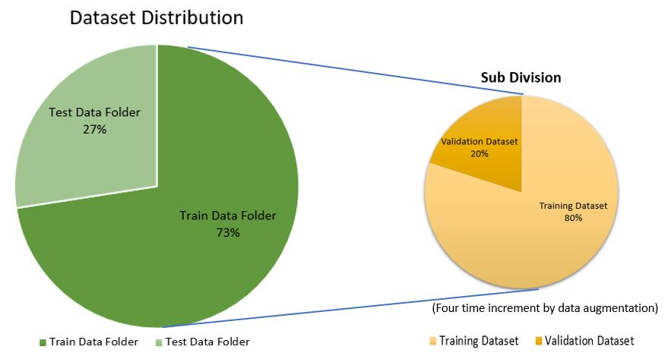
Folder splitting of dataset

Slide 4
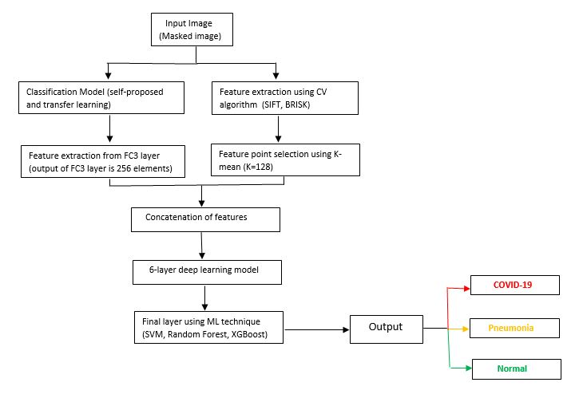
Pipeline
Flow chart showing Proposed pipeline for classification

Slide 5
Algorithms
A. Dataset Preprocessing
B. Image Masking using C-GAN
C. Image Classification

Slide 6
Dataset processing
The very first step for this project is getting the dataset we have downloaded our dataset from different resources as per requirement in the jpg mode.
Dataset covid-19 --> (930 images)
We download this dataset from the github
Dataset Normal and Pneumonia --> (Normal --> 1585 Images and Pneumonia --> 4275 Images)
We download this dataset from kaggle website
Dataset Segmentation → (total images 247 and after augmentation 988 images i.e. 4 times increase in dataset by flipping and mirroring the images)

Slide 7
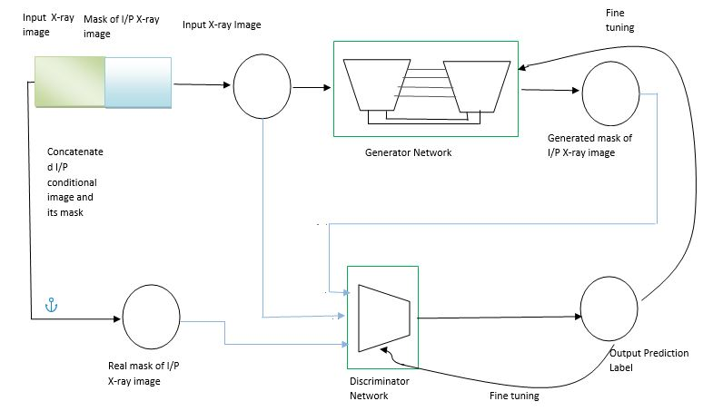
Image masking using C-GAN
For training the masking network we used the Conditional-GANs and implemented a algorithm proposed in paper named “Image-to-Image Translation with Conditional Adversarial Networks”.
Each level in the generator encoder u-net network is (Conv -> Batch-norm -> Leaky ReLU)
Each level in the generator decoder u-net network is (Transposed Conv -> Batch-norm -> Dropout. )applied
to the first 3 blocks) -> ReLU
Each level of the discriminator consists of (Conv -> Batch-Norm -> Leaky ReLU)

Slide 8
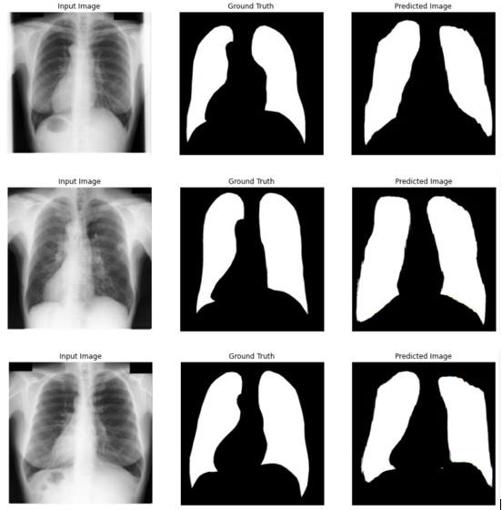
The samples of the outputs which were obtained after training the Generator Network of the C-GAN by this algorithm.
Samples of the generated mask by the masking model along with the actual mask and input x-ray image

Slide 9
Image Classification
In the Image Classification part, we proposed a pipeline which contains various elements of Deep Learning, Machine Learning and Computer Vision. A detailed analysis and study of this pipeline with various Deep Learning models is done and then the results of this analysis decide the best compatibility of DL models with the image/feature post processing. For this analysis we selected these models for transfer learning along with a self created general deep convolutional model (similar to Alex-Net) for refrence purpose.
DenseNet169
DenseNet 201
VGG16
VGG19

Slide 10
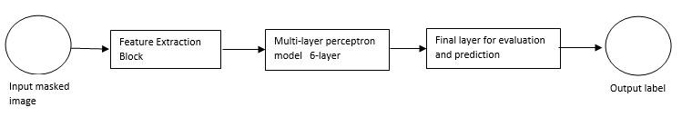
we also made a Simple Convolution Network for reference and to check how better the network is performing from this simple convolutional network at every step of the pipeline. The whole pipeline as shown in figure number in introduction can be represented in three major blocks.
compacted flow diagram for the proposed pipeline

Slide 11
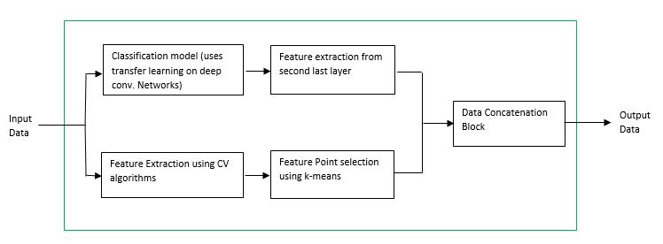
Feature Extraction Block
The first block in this pipeline is a feature extraction block which consists of two major parts, one is the Deep Convolutional Neural Network model and other is a Computer Vision algorithm which is used to extract useful information from the image which is given to it.
Flow diagram explaining the elements in the Feature Extraction block

Slide 12
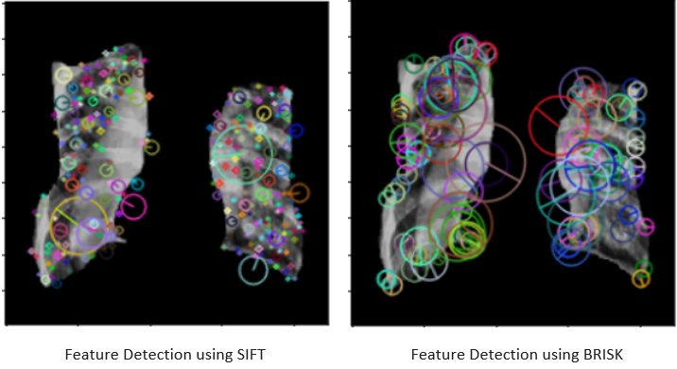
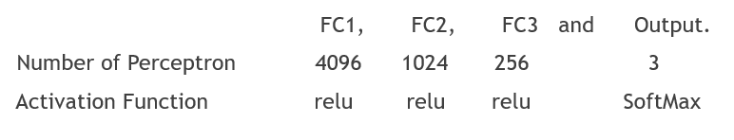
Feature Detection using SIFT and BRISK
Table labeling the features of self added 4 fully connected flatten layers in the transfer learning model at the end
Images visually represented the detected features by SIFT and BRISK algorithm on a sample x-ray image

Slide 13
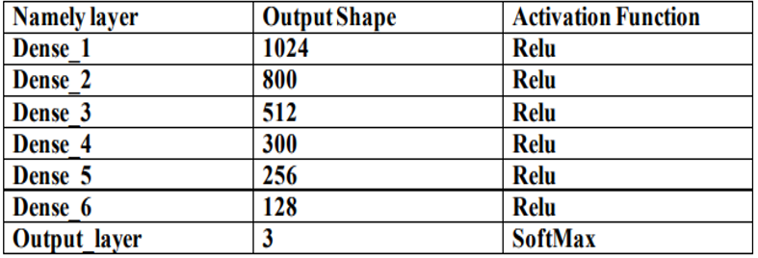
Multilayer Perceptron Model
This is a Deep Neural Network model which takes in the concatenated features from the previous blocks and then based on the assigned labels to these input features we train the network to predict the correct labels to the given information. The input of the deep learning model is a vector of length 384 with 256 features coming from the transfer learning model’s second last or fc3 layer and the remaining 128 features coming from the 128 cluster mean points of the extracted features using SIFT or BRISK algorithm.
Table mentioning the layer description of the multilayer perceptron model

Slide 14
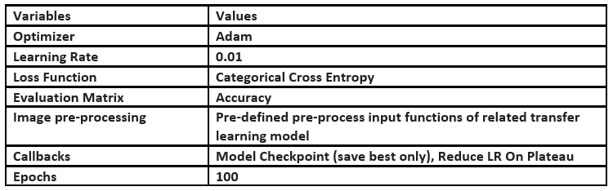
Final layer for evaluation and prediction
The final layer consists of an evaluation layer which has either the output layer from the model using SoftMax activation function for classification or either of the svm, XG-boost or random forest ML algorithm to classify the final images into the three labeled classes. We then see whether the ML algorithms helped with the specific transfer learning model in the given pipeline to improve its classification results at last or not.
Table listing the various parameters used during the classification model training process

Slide 15
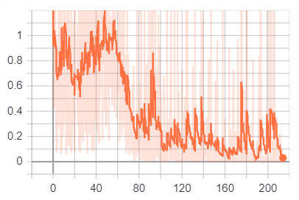
Simulation results
Results from training the masking model
We used the Conditional GANs with image-to-image translation algorithm [link to paper] for training the masking model. The model was set to train for 247 epochs as there were only 247 training images available, but due to the restriction of buffer space for the storing the results on google collab we restricted our training to 215 epochs only and also with this much training we got satisfactory results. The results of the masking models on the images is already shown in the algorithm part in figure number abc. Below are the graphs of the optimization of the loss functions with respect to the number of epochs.
Graph for discriminator loss conversion for C-GAN
.
As we can see from the graph above with epochs the discriminator loss varies and oscillates between high and low values, this is do because the generator loss also improves with time which in turn forces the discriminator loss to increase which in return again changes its parameters to reduce the loss but as we can see that the all over loss function is decreasing as the number of epochs are increasing which means the discriminator is becoming more and more capable to discriminate between the real and the fake or generated masks.

Slide 16
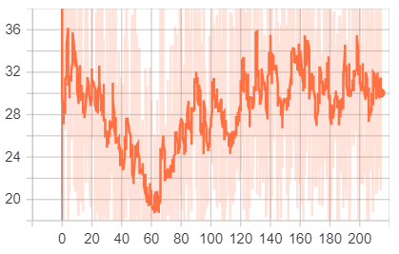
Generator loss
As we can see that the generator total loss is a combination above two losses which like the discriminator loss oscillates from high values to low values, in starting we can see that it was decreasing rapidly because the discriminator was not trained well to classify between the real and fake/generated images and it was easy for the generator model to learn the macro features of the mask after that it increases and then oscillates with as slow decreasing trend because now the discriminator is also trained to identify between real and fake masks and also it is becoming more difficult for the generator model to learn the micro features of the mask which are basically the edges of the mask or boundaries of the lungs in the chest x-ray.
Total Generator Loss Graph with increase in Epochs

Slide 17
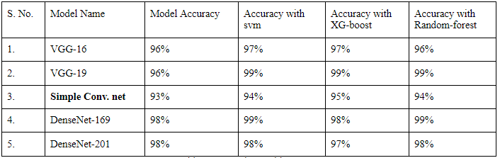
Results from the Classification Pipeline →
Accuracy with validation dataset
The accuracy of models at their first stage of the pipeline, i.e. only with the transfer-learning. (Best model accuracy during training epoch)

Slide 18
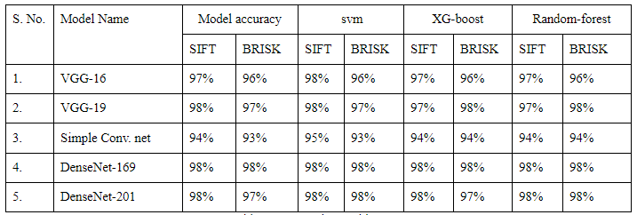
The accuracy of model after combination with the features from SIFT/BRISK Algorithm.

Slide 19
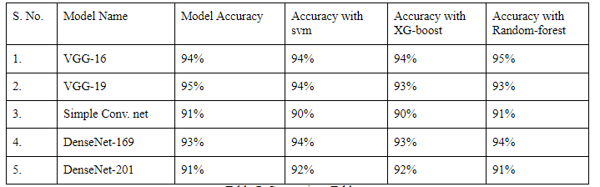
Accuracy with Test Dataset
The accuracy of models at their first stage of the pipeline, i.e. only with the transfer-learning.

Slide 20
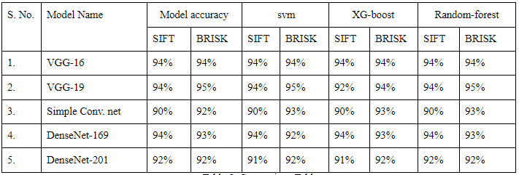
The accuracy of model after combination with the features from SIFT/BRISK Algorithm.

Slide 21
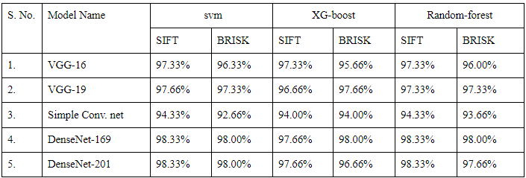
Average F1 Score
F1 score with validation dataset

Slide 22
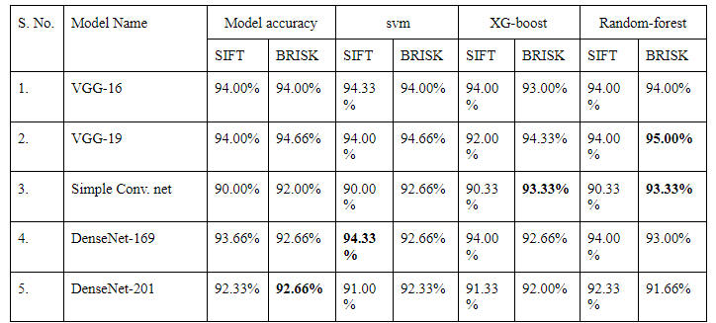
F1 score with test dataset

Slide 23
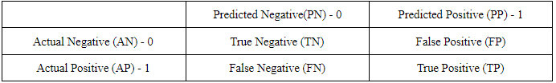
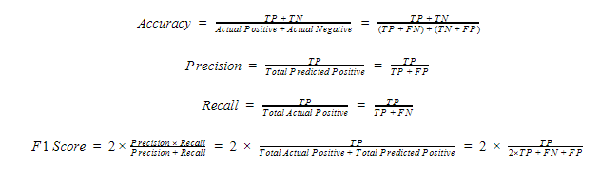
Discussion
Distribution Table/confusion for mathematical analysis
Now from the above table we can define some following terms and the terms that are used in the observation table.
Now as we can observe from the above tables for accuracy and F1 scores (average) that the VGG-19 and VGG-16 were the two models which performed best on the test dataset and also performed well during training on the validation dataset.

Slide 24
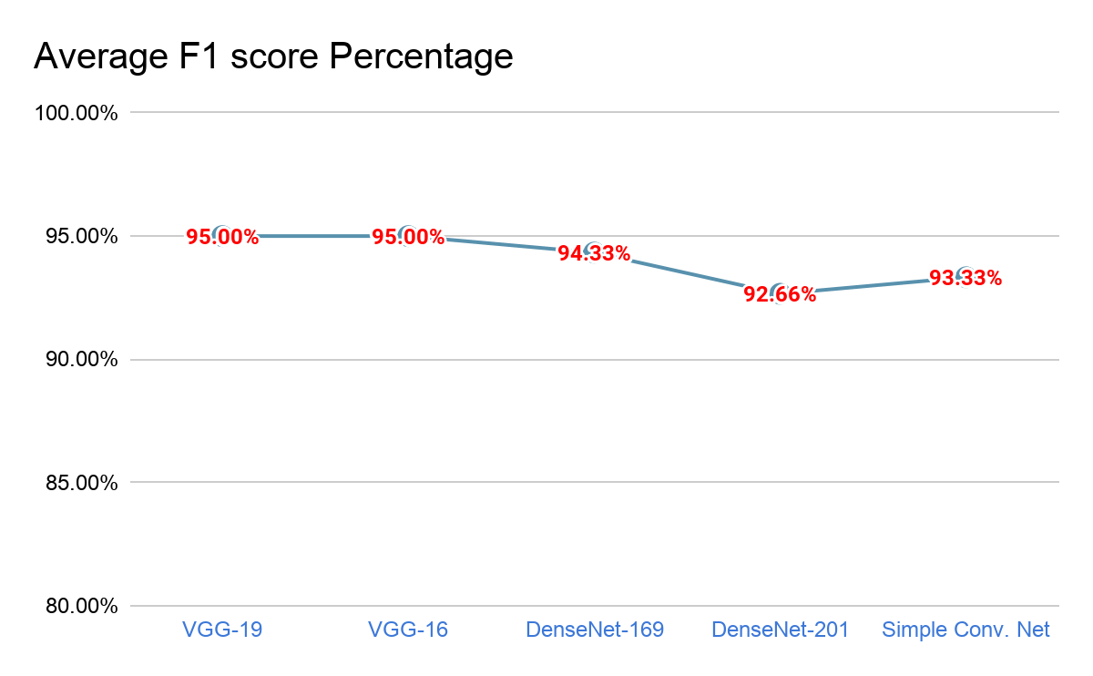
Discussion
We can observe from the tables that there were also some cases where the final best average F1 score for classification was low from the pipeline as compared to the only transfer learning based model as in case of VGG-16, but except this model in all other models the final best average F1 score was increased through our proposed pipeline. In the table given below we have given the best performance of models through the pipeline level and their respective average F1 scores.
Result Table showing maximum accuracy of each models at corresponding levels

Slide 25
Conclusion
So, from the previous analysis on the whole proposed pipeline we came to the conclusion that the VGG-19 performed best on the test dataset with 95% accuracy through the help of the proposed pipeline and also at every step the average F1 score of the model increases where as the VGG-16 performed best without the pipeline but using Randomforest as the last classification layer and gives the same test accuracy of 95% on the test dataset. Hence VGG-19 and VGG-16 were the two best performing models out of the 5 selected models for this classification task with and without pipeline respectively.

Slide 26
References
[1]. Covid-chestxray-dataset, Joseph Paul Cohen, ieee8023
[2]. Chest X-ray images (Pneumonia), Paul Mooney
[3]. Segmentation of anatomical structures in chest radiographs using supervised methods: a comparative study on a public database, B. van Ginneken, M.B. Stegmann, M. Loog, Medical Image Analysis, 2006, nr. 1, vol. 10, pp. 19-40.
[4]. Image-to-Image Translation with Conditional Adversarial Networks, Phillip Isola, Jun-Yan Zhu, Tinghui Zhou, Alexei A. Efros, arXiv:1611.07004v3 [cs.CV] 26 Nov 2018
[5]. Generative Adversarial Nets, Ian J. Goodfellow, Jean Pouget-Abadie∗ , Mehdi Mirza, Bing Xu, David Warde-Farley, Sherjil Ozair† , Aaron Courville, Yoshua Bengio‡, arXiv:1406.2661v1 [stat.ML] 10 Jun 2014
[6]. CycleGAN and pix2pix in PyTorch, Jun-Yan Zhu
[7]. Deep Learning COVID-19 Features on CXR using Limited Training Data Sets Yujin Oh1 , Sangjoon Park1 , and Jong Chul Ye, Fellow, IEEE, arXiv:2004.05758v2 [eess.IV] 5 May 2020
[8]. Review of Artificial Intelligence Techniques in Imaging Data Acquisition, Segmentation and Diagnosis for COVID-19 Feng Shi † , Jun Wang † , Jun Shi † , Ziyan Wu, Qian Wang, Zhenyu Tang, Kelei He, Yinghuan Shi, Dinggang Shen, April 6, 2020.

Slide 27
9]. Inf-Net: Automatic COVID-19 Lung Infection Segmentation from CT Images, Deng-Ping Fan, Tao Zhou, Ge-Peng Ji, Yi Zhou, Geng Chen, Huazhu Fu, Jianbing Shen, and Ling Shao, arXiv:2004.14133v4 [eess.IV] 21 May 2020
[10]. Automatic Detection of COVID-19 and Pneumonia from Chest XRay using Transfer Learning, Sarath Pathari & Rahul U
[11]. COVID-19 Prediction and Detection Using Deep Learning Moutaz Alazab1 , Albara Awajan1 , Abdelwadood Mesleh1 , Ajith Abraham2 , Vansh Jatana3 , Salah Alhyari4 ,
[12]. OptCoNet: an optimized convolutional neural network for an automatic diagnosis of COVID-19 Tripti Goel1 & R. Murugan1 & Seyedali Mirjalili2 & Deba Kumar Chakrabartty3
[13]. Deep learning based detection and analysis of COVID-19 on chest X-ray images Rachna Jain1 & Meenu Gupta2 & Soham Taneja1 & D. Jude Hemanth3
[14]. COVID-Net: A Tailored Deep Convolutional Neural Network Design for Detection of COVID-19 Cases from Chest X-Ray Images Linda Wang1,2,3*, Zhong Qiu Lin1,2,3, and Alexander Wong1,2,3
[15]. Detection of COVID-19 from Chest X-Ray Images Using Convolutional Neural Networks Boran Sekeroglu1 and Ilker Ozsahin2

Slide 28
THANKS

